Slide 1

Species Distribution Models (SDM)

Slide 2




LAYA ZEINALI Ph.D. candidate at Tarbiat Modares university, Tehran, Iran
I am researching in forest remote sensing and modeling and cooperated in various environmental project. I interested in climate change issues and ecosystem services and my thesis is about theses topics in hyrcanian forests in north of Iran.

Slide 3
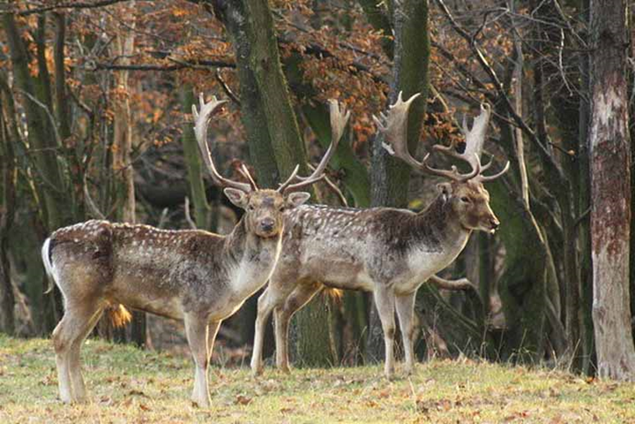
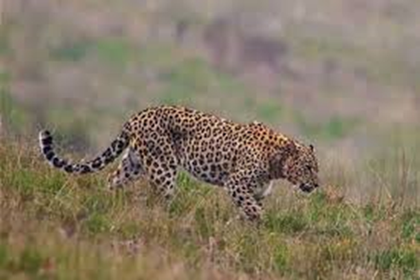

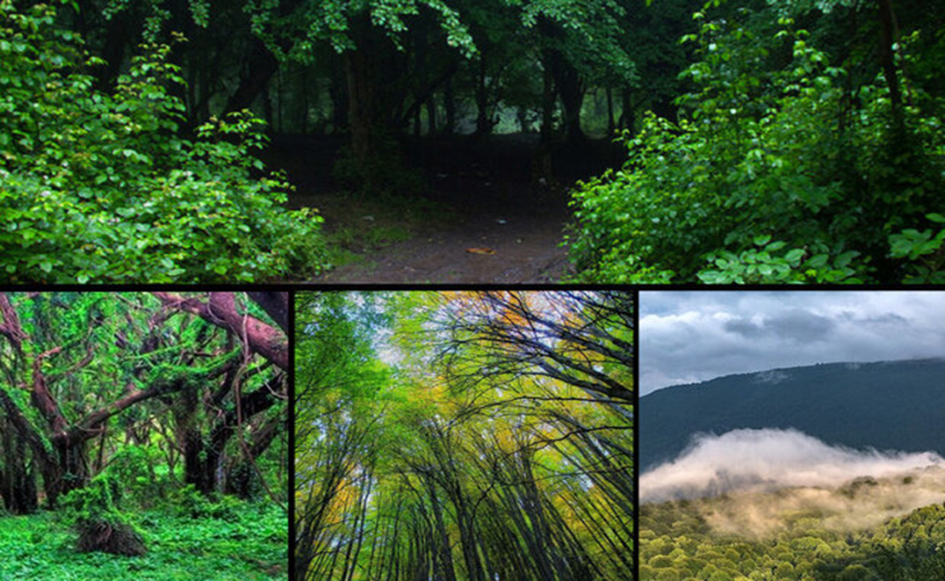

Hyrcanian forests

Slide 4


The total number of environmental variables is 19. which is prepared based on average rate of precipitation, minimum, maximum and average temperature for 12 months of the year.
In general, the data are divided into two categories: spatial and non-spatial.
Spatial data is divided into two categories: vector (point, line and polygon) and raster (pixel base) (descriptive data is also included in this category).

Slide 5
Steps to perform the work:
rio
SF
raster
rio
Import, Export, and Convert Data Files
SF
a standardized way to encode spatial vector data
raster
geographic data analysis and modeling

Slide 6

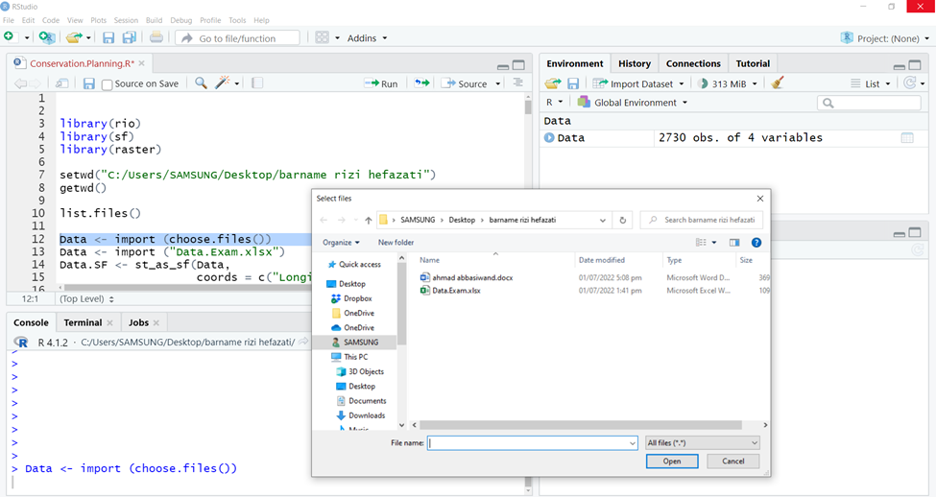
We can use two methods to load our data into the R software environment: In the first method, you can use the rio package with the command:’
Data <- import (choose files ())

Slide 7
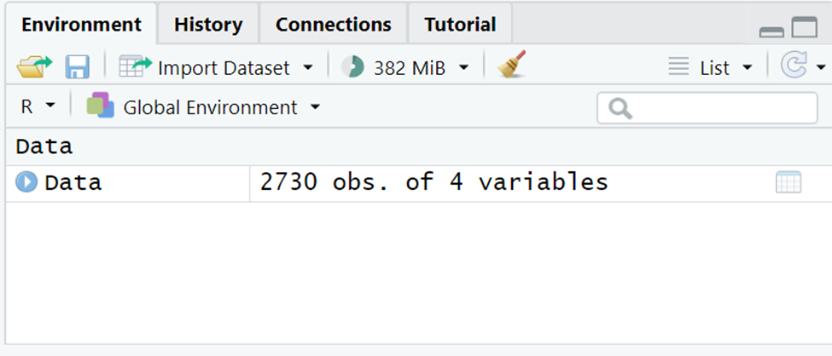
In the second method, it is possible to set the working directory:
setwd ("C:/Users/LAYA/Desktop/SDM)
Using the list.files () command, you can see all the files in the folder and then select the desired file.
Data <- import ("Data.SDM.xlsx")

Slide 8
Second step
We use the SF package to convert the data into a spatial object. which we called it at first.
Data.SF <- st_as_sf (Data, coords = c("X "," Y "), crs=4326)
Geographical reference coordinate systems define points on the earth's surface with the help of longitude and latitude values. These values are the angles measured from the center of the Earth with zero longitude located on a given meridian.

Slide 9
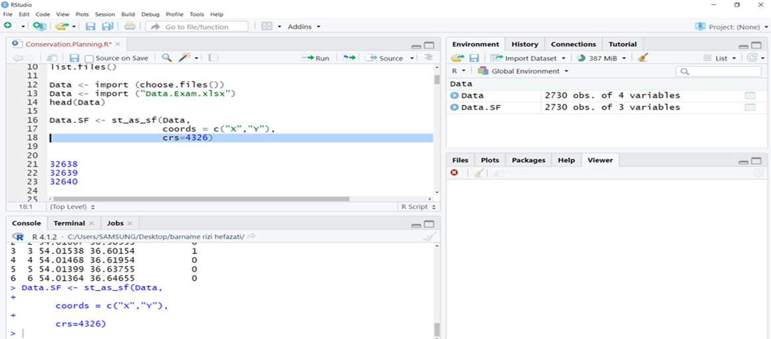

Slide 10
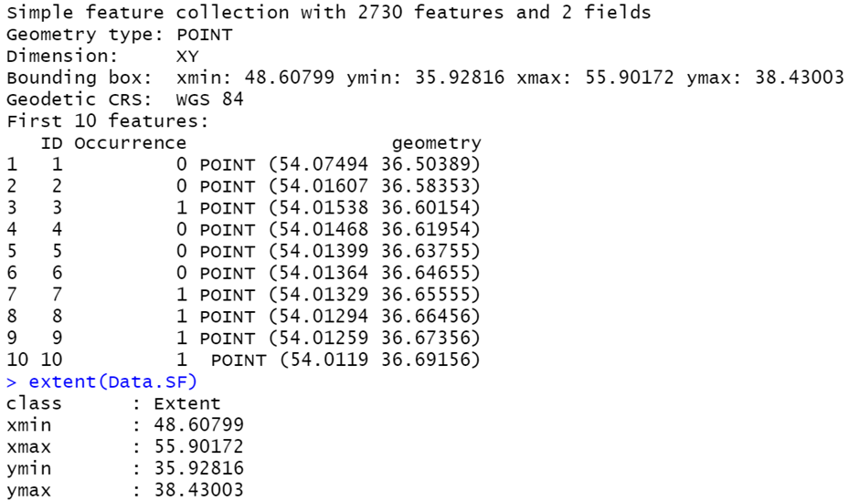
Data.SF
(Data.SF) Extent

Slide 11
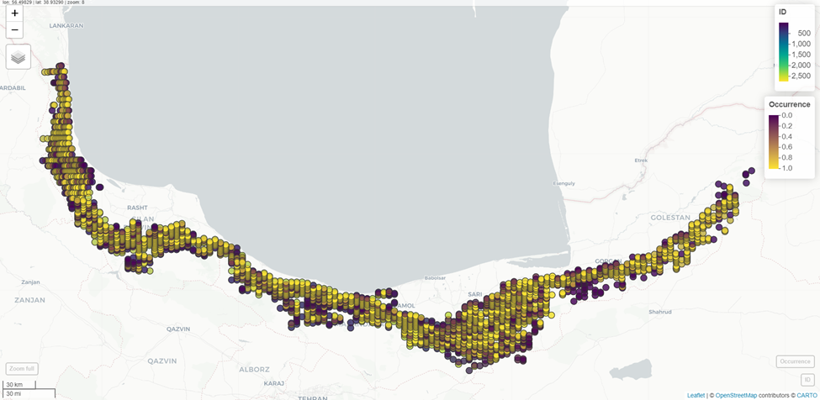
library(mapview)

Slide 12
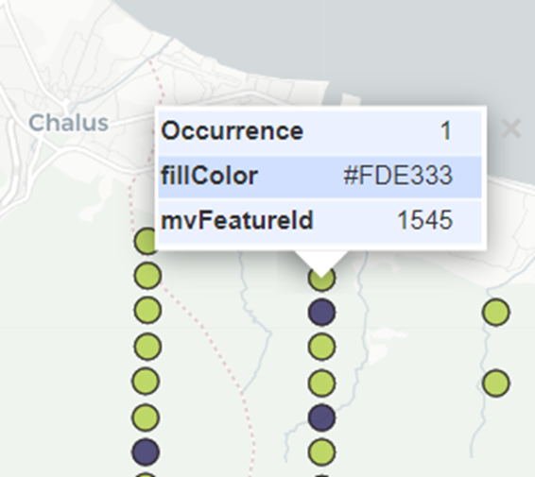
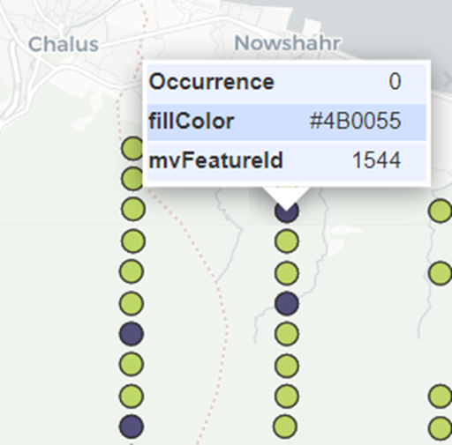

Slide 13

Our spatial object may be constructed using the SF or SP function. To switch between these two functions, we use the following command:
Convert SF to SP:
Data.SP <- as (Data.SF, "Spatial")
Data.SP
Convert SP to SF:
Data.SF2 <- st_as_sf (Data.sp)
Data.SF2

Slide 14
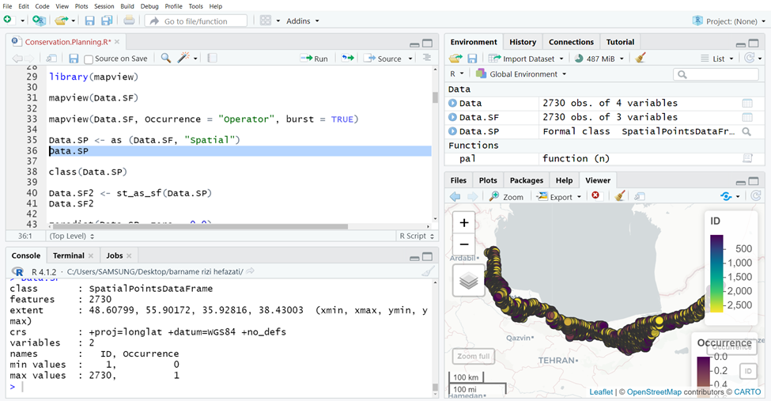

Slide 15
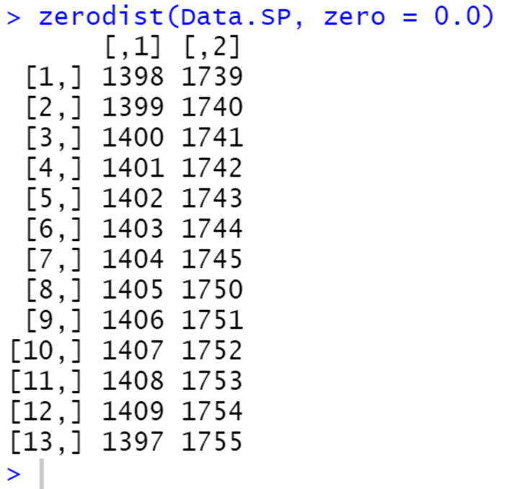
To determine whether we have the same coordinates or not, the following function can be used:
Zerodist (Data.SP, zero = 0.0)

Slide 16
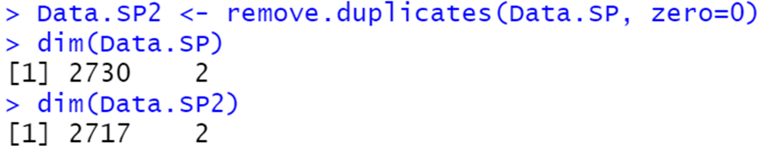
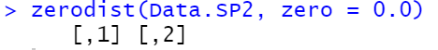
Data.SP 2<- remove.duplicates (Data.SP, zero=0)

Slide 17
Next step
MAPPING
To prepare mapping, we need different maps, including environmental maps, starting from BIO 1 and ending at BIO 19.
In the next step, we enter environmental maps from 1 to 19 into the software with the following command:
Bio1 <- raster ("Bio1_Ver1.tif")
Bio1
The above command is repeated for all 19 maps.

Slide 18
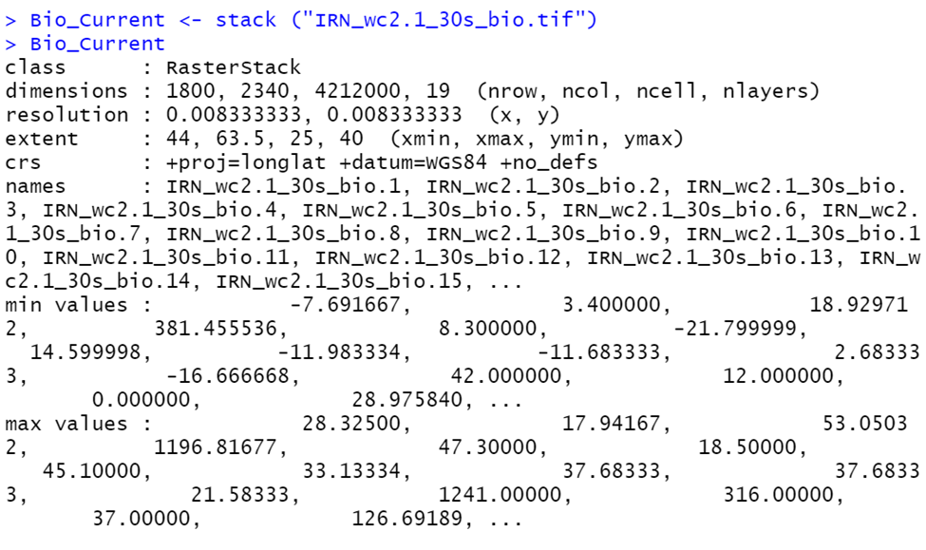

Slide 19
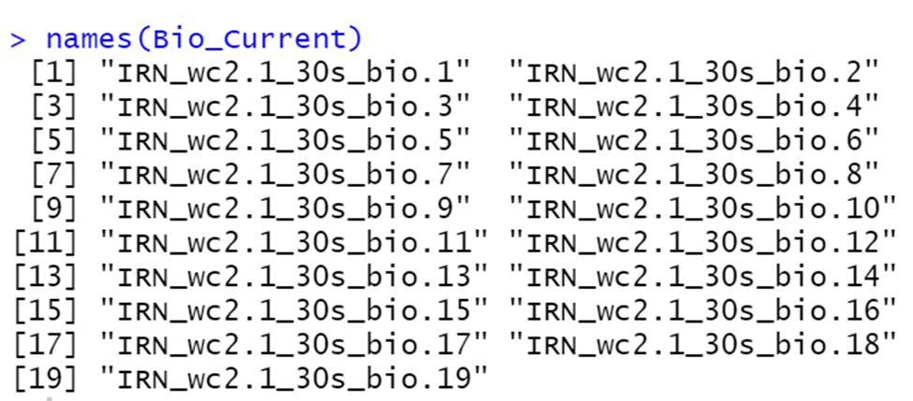
All 19 bands can be viewed using the Names command:

Slide 20
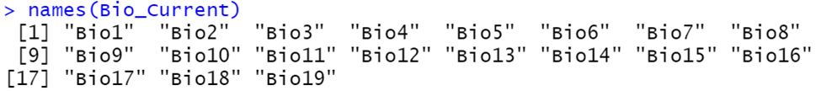
names (Bio_Current) <- c ("Bio1", "Bio2", "Bio3", "Bio4","Bio5","Bio6","Bio","7Bio8","Bio9","Bio10","Bio11","Bio12","Bio13","Bio14","Bio15","Bio16","Bio17","Bio18","Bio19"(

Slide 21
Next step: uploading the shape file of Hyrcanian region
Using the following command, we add the map of Hyrcanian region to the software:
Hyrcanian_Area <- shapefile ("Hyrcanian_Study_Area/Study_Area.shp")
Using the following commands, we draw the diagram of the Hyrcanian region and add points to it:
x ()11
plot (Hyrcanian_Area)
plot (Data.SP2, add=TRUE)

Slide 22
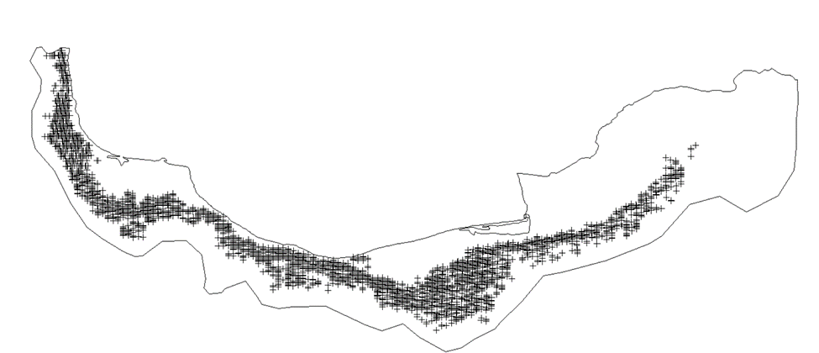

Slide 23
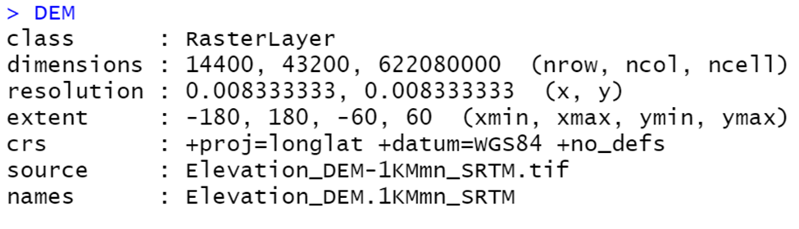
The next step is to import the DEM map:
We add the DEM map to the software using the following command:
DEM <- raster ("Elevation_DEM-1KMmn_SRTM.tif")

Slide 24
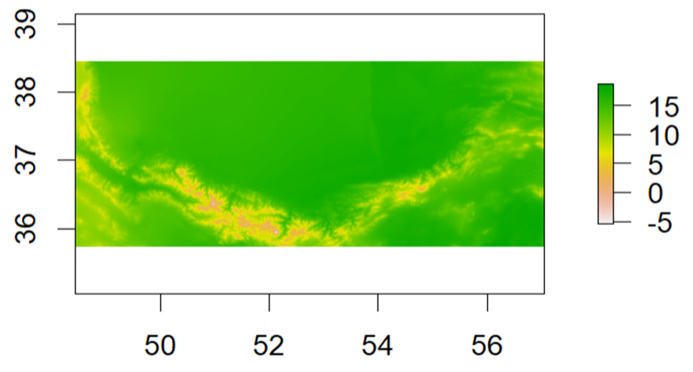
Plot (Bio_Current_Crop$Bio1)

Slide 25
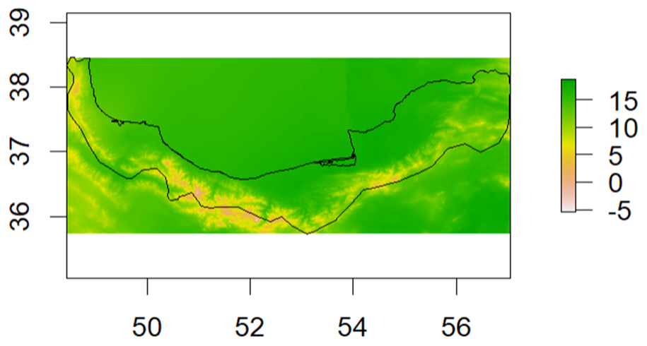
Plot (Bio_Current$Bio1)
Plot (Bio_Current_Crop$Bio1)
Plot (Hyrcanian_Area, add=TRUE)

Slide 26
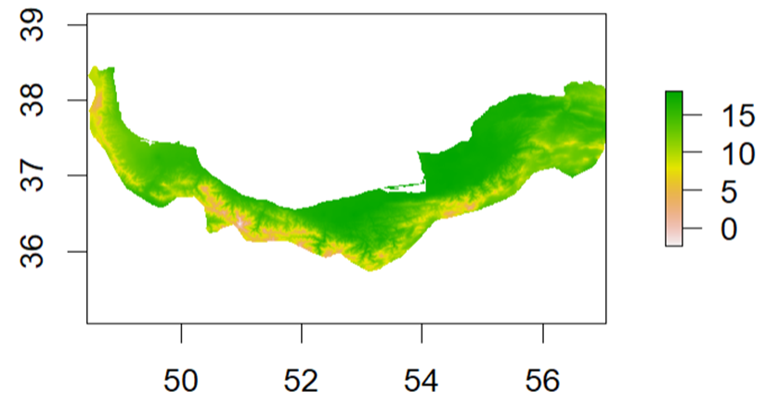
Bio_Current_Mask <- mask (Bio_Current_Crop, Hyrcanian_Area)
Plot (Bio_Current_Mask$Bio1)

Slide 27
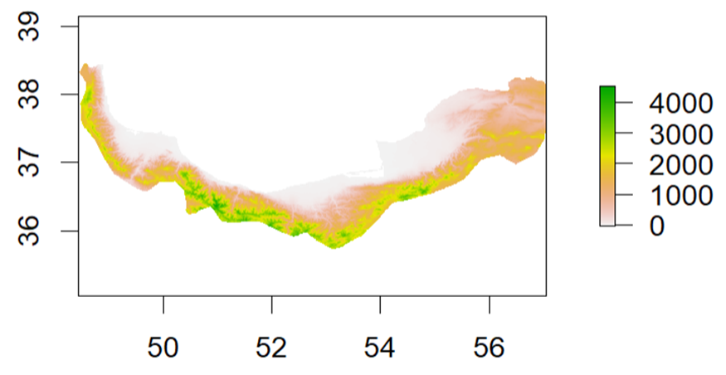

Slide 28
Slope <- terrain (DEM, opt="Slope", unit="tangent")
Slope <- Slope * 100
Aspect <- terrain (DEM, opt="aspect", unit="degrees")
Aspect
Names (Slope) <- "Slope"
Names (Aspect) <- "Aspect"

Slide 29
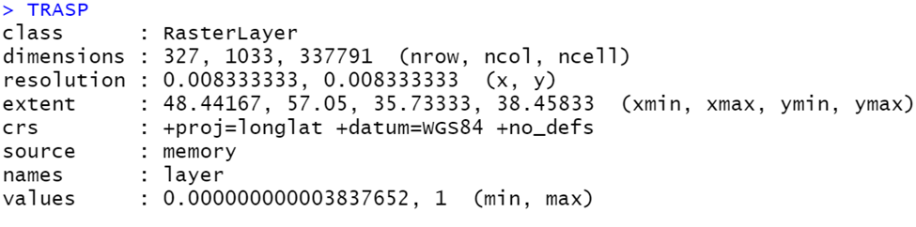
Then we use a solar radiation index using the following command:
TRASP = (1 - cos((pi/180) * (Aspect -30)))/2
Then, we use the following command to exit the display mode:
Options (scipen = 999)
TRASP

Slide 30
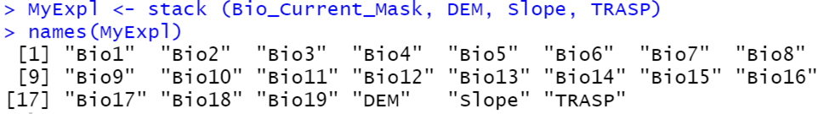
Next step: stacking the maps we made.
MyExpl <- stack (Bio_Current_Mask, DEM, Slope, TRASP)
Data.Envi <- extract (MyExpl, Data.SP2)

Slide 31
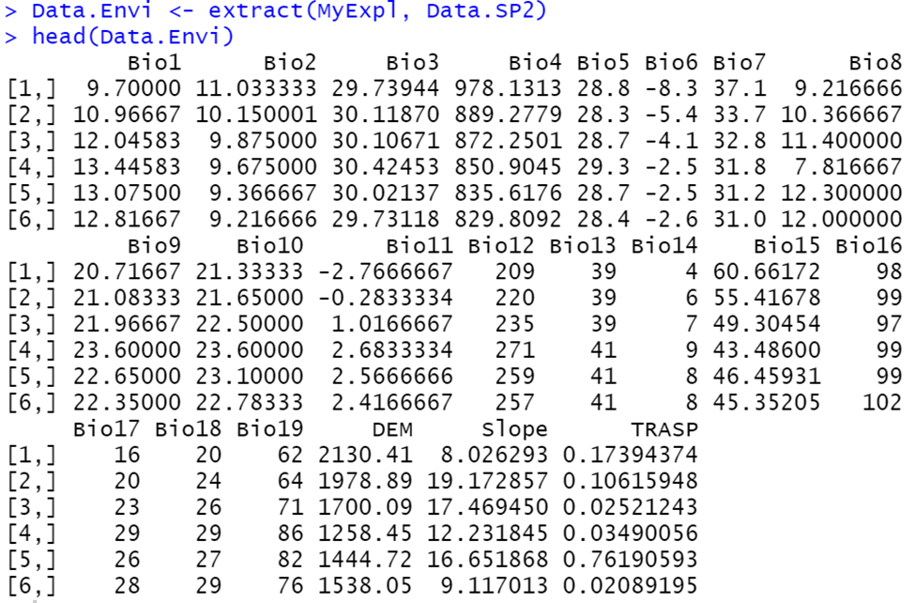

Slide 32
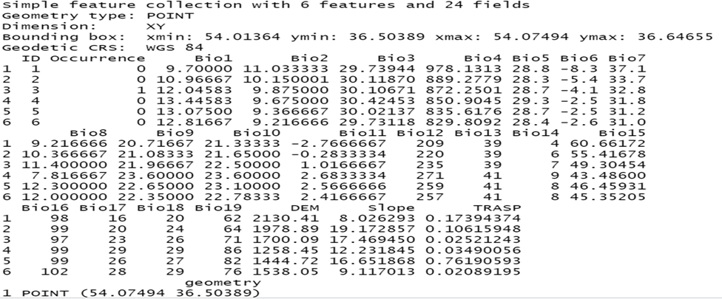
Data.Envi.Final <- cbind (Data.SF, Data.Envi)

Slide 33
Next step: Examining the collinearity problem
Using the usdm package to fix the collinearity problem (when there is correlation between the variables).
MyExpl_NoCor <- vifstep (MyExpl, th = 10)
Use the above command to fix this problem (specifying those whose VIF is greater than 10 are identified).

Slide 34
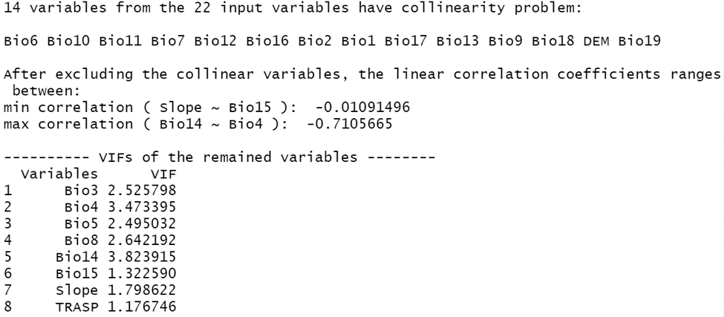

Slide 35
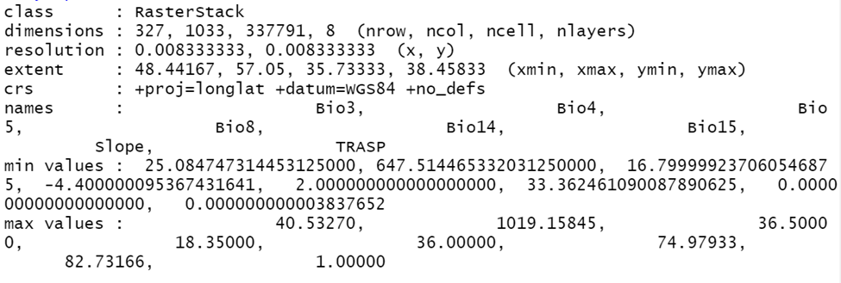
MyExpl_Reduced <- exclude (MyExpl, MyExpl_NoCor)

Slide 36
Next step
Modeling
The logistic regression model
This model is used when our data is 0 and 1 (presence and absence).
GLM <- glm (Occurrence ~ Bio3 + Bio4 + Bio5 + Bio8 + Bio14 + Bio15 + Slope + TRASP, family="binomial", data=Data.Envi.Final)

Slide 37
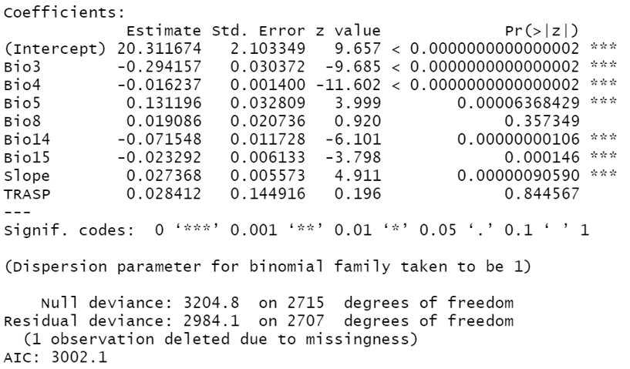

Slide 38
StepAIC (GLM, direction = "both")
StepAIC (GLM, direction = "both", k=log (nrow (Data.Envi.Final)))
Glm (formula = Occurrence ~ Bio3 + Bio4 + Bio5 + Bio14 + Bio15 + Slope, family = "binomial", data = Data.Envi.Final)
summary(GLM.Final)

Slide 39
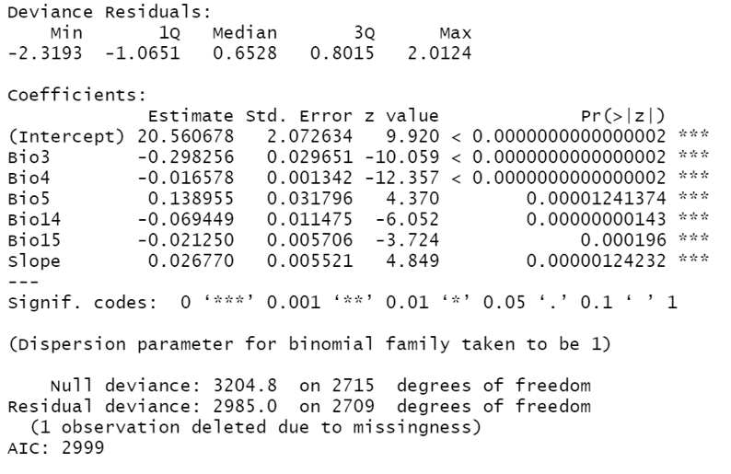

Slide 40
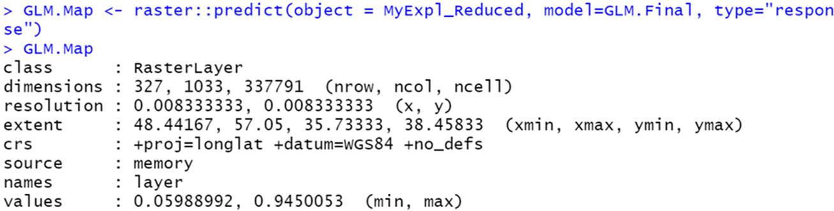
last step
preparing the final map
GLM.Map <- raster::predict(object = MyExpl_Reduced, model=GLM.Final, type="response")
GLM.Map
Plot (GLM.Map)
Mapview (GLM.Map)

Slide 41
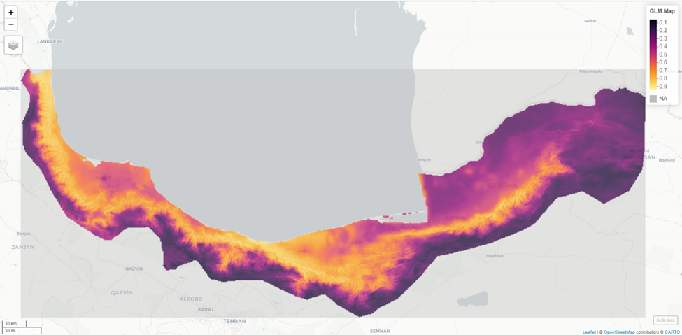

Slide 42
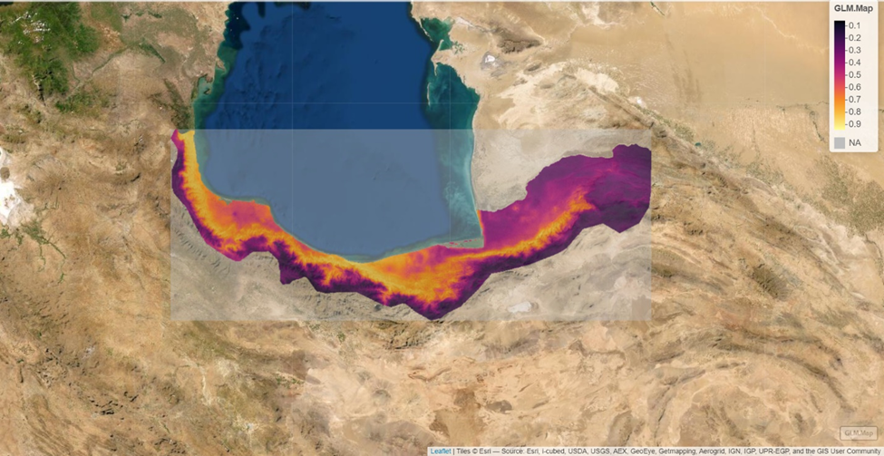

Slide 43
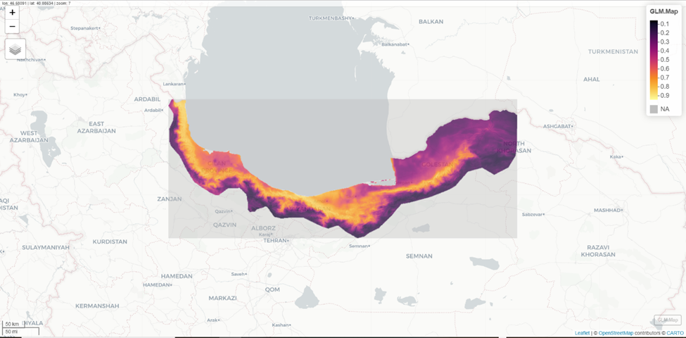

Slide 44
The final map is drawn using the following commands:
x11()
png ("GLM.Map.png", width=20, height = 18, units = "in",res=600)
plot(GLM.Map)
dev.off()

Slide 45
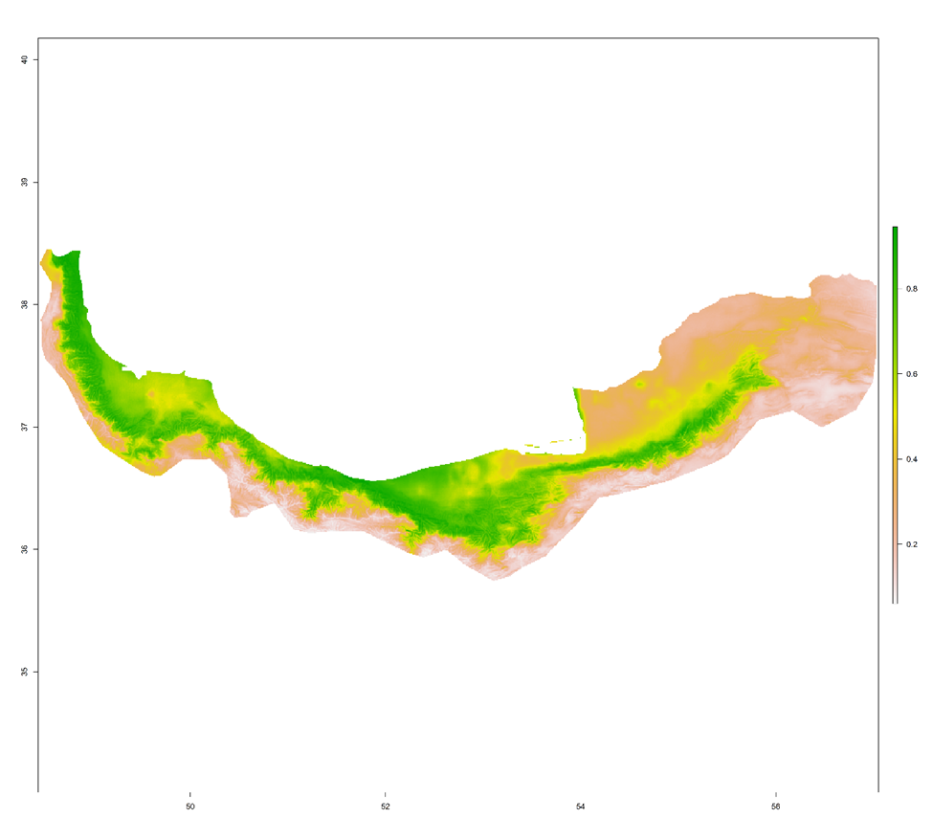

Slide 46
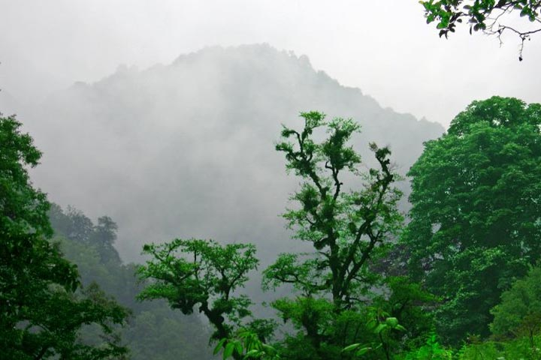
With kind regards
Q & A
Contact me:
Email: zeinaliyadegarilaya@modares.ac.ir
Twitter: laya_zeinali
Instagram: laya_zeinali
Linkedln: layazeinali
Researchgate: laya zeinali

